Slide 1
MagSails - Sep. 3 update
Codes for magnetic field and MHD simulations

Slide 2
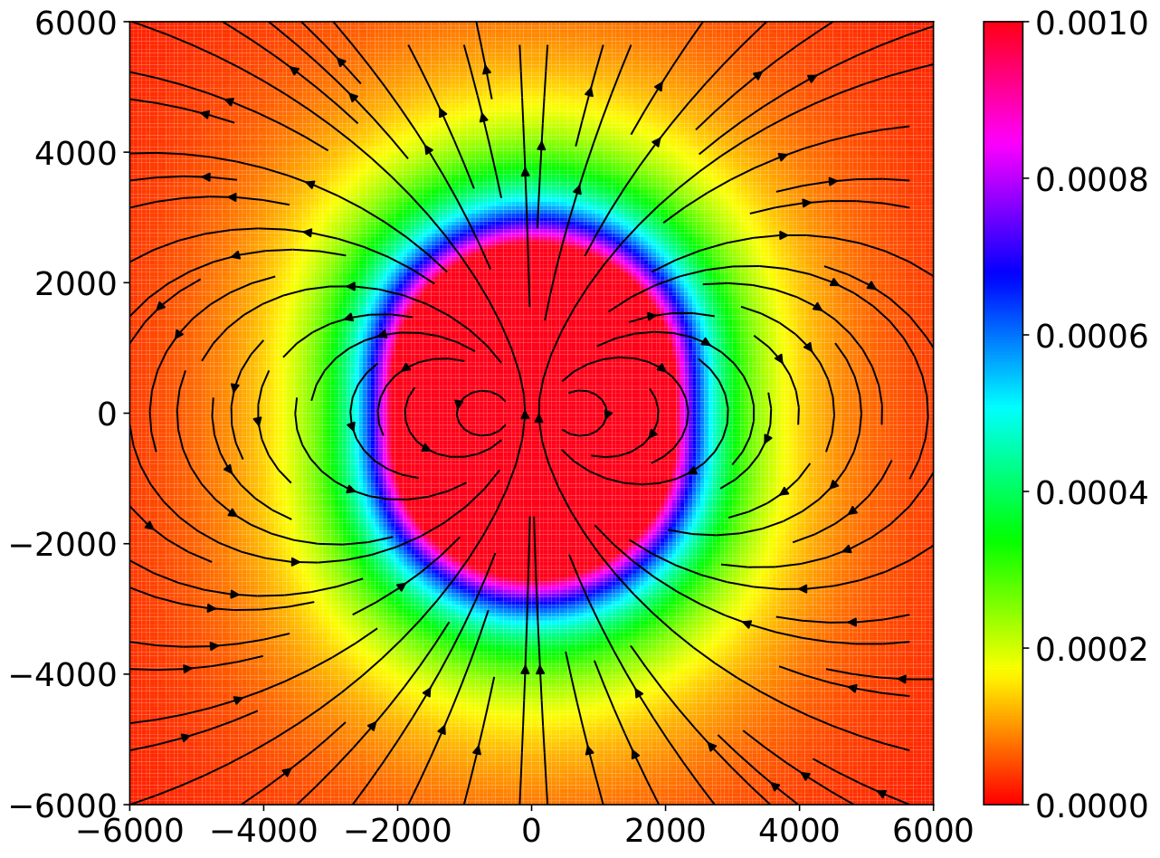
Mag. field of 1 m dia. loop
Z (mm)
B (mT)
X (mm)

Slide 3
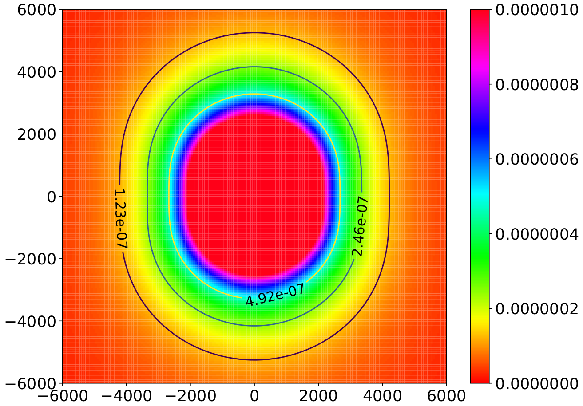
B = 2.46E-07T is the nominal boundary; standoff dis ~ 4 m
Z (mm)
B (T)
X (mm)

Slide 4
Space Weather Model
I have the MHD code SWMF from University of Michigan.
Also have one of the developer’s in email contact for any potential queries.

